Slide 1
Adobe Analytics 2019
ND D.R.Y. Team
Doris Kuo
Rongbin Ye
Ye Yuan
Adobe Analytics Challenge

Slide 2
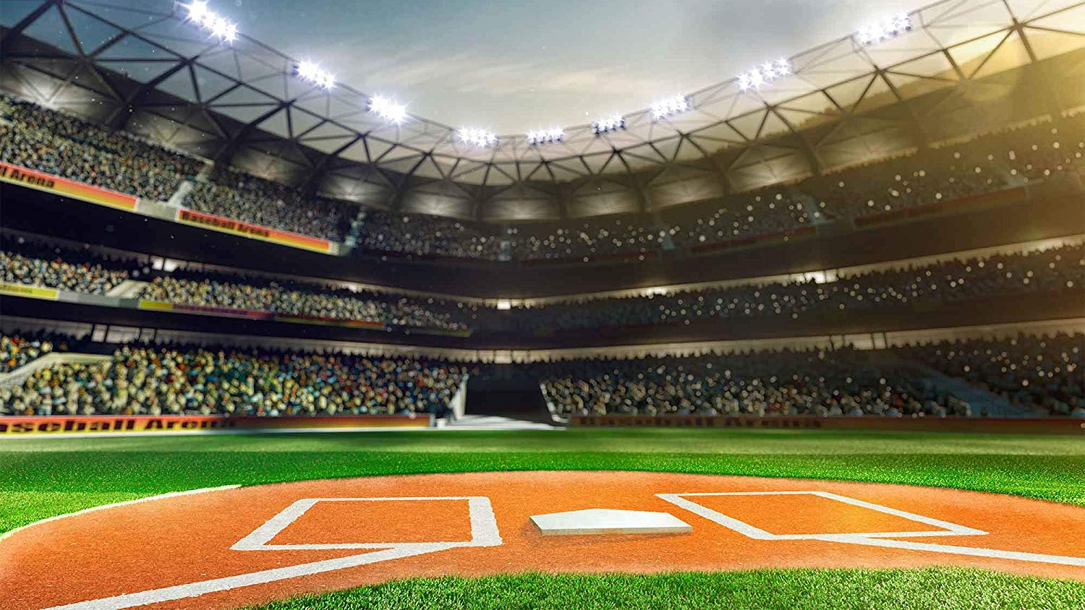

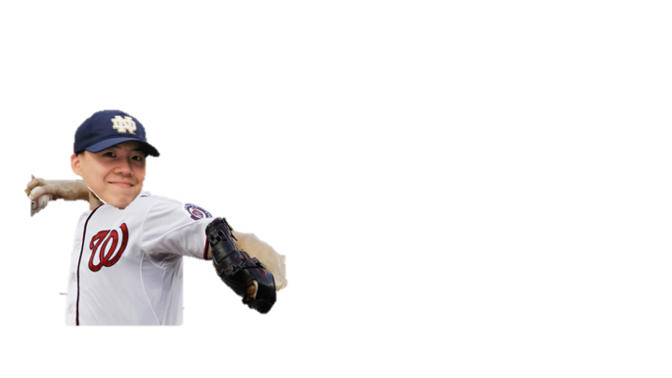

Our Team: ND D.R.Y.
University of Notre Dame
MSBA 2020
Catcher: Doris Kuo
Pitcher: Rongbin Ye
Batter: Ye Yuan
Honored Catcher: Prof. Sharif Nijim

Slide 3


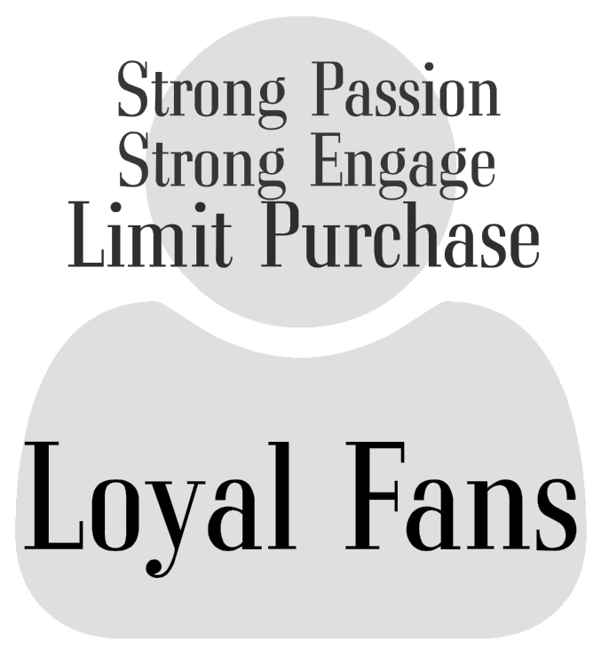

Challenges & Goals
How can MLB bring a beloved in-stadium experience and create the same excitement and personalized touch online? Improve the Relay of audiences
How to convert non-fans into fans?
How to convince fans into frantic fans?
How to increase the engagement?
How to maintain frantic fans?
Notes:
(40s) Understood the data and operation of the MLB.com and AT BAT apps, we recreated and concentrated the question to the fans and MLB connection, represented in four stages: Non fans, new fans, loyal fans and frantic fans.s To overcome barriers among different engage stages, we need to improve relay among these stages and answer four sub questions.

Slide 4







Recommendation
MLB Champion GO, Team Membership, Tokenized Gamble, and Virtual Space will alleviate the audience’s experience from normal audiences to frantic fans
MLB Champion GO
Team Membership
Tokenized Gamble
Virtual Space
NYY
Create interactive in-stadium experience
Tailored exposure and connection for team fans.
Gambling for fun and rewards in stadium and online
Bounding connection with families
AR user ratio: 84%
Est. Revenue: 57.6M
Exchange Ratio: 65%
Iteration ratio: 1.8
Notes:
(60s)To ensure the implementation of these recommendations, we listed the calculation as follow. The estimated AR user ratio, the ratio of Go users in fans arrived 2 hours to 40 minutes before the game, is based on total areas of one standard deviation above mean (84%). The est. revenue of membership sales, average est.members purchasers per month * months * teams * team member price, is estimated 57.6 M annually across the U.S.. The exchange rate of rewards refers to the ratio of members exchange rewards to all team members in loyal programs. The iteration ratio refers to the ratio of young new fans introduced by old frantic fans, estimated to 1.766 (average fertility rate in U.S.)

Slide 5
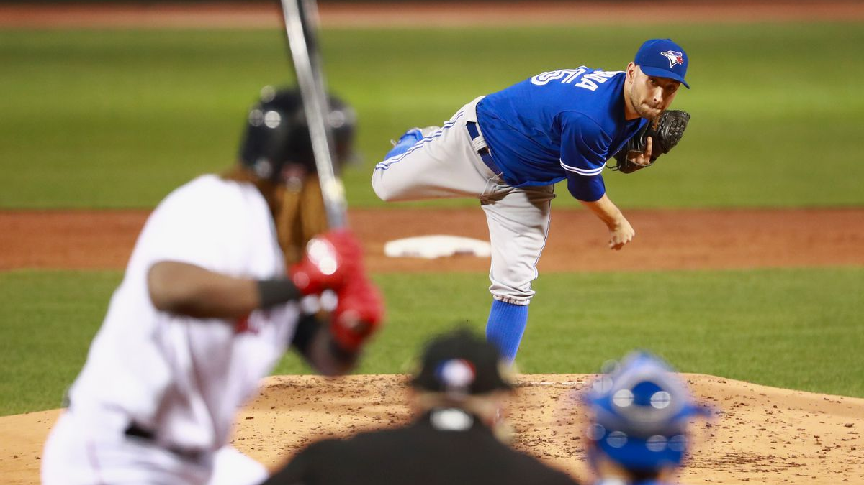
Finding Through Analysis
Through the lens of Adobe Analytics

Slide 6
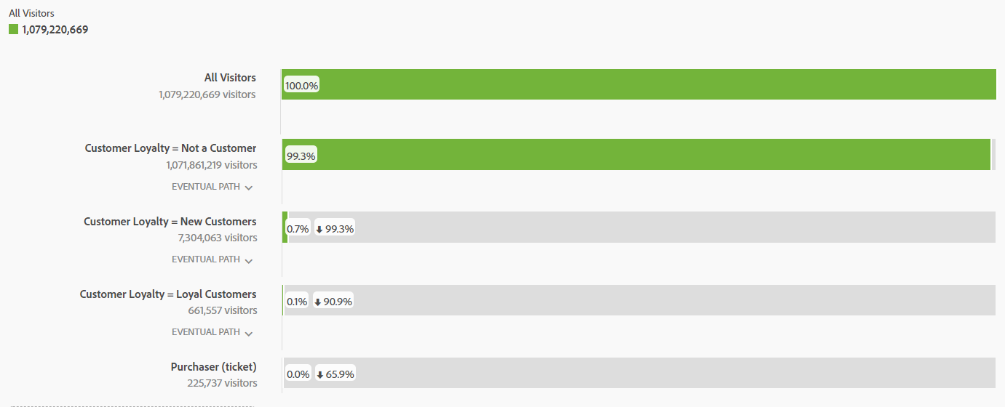
Challenge Analysis
This fallout table demonstrates multiple barriers for customers in different stages to enter a higher engagement level
Date: 2016/10/01 - 2019/10/01
Notes:
(15s)Currently, only an extremely low percentage of our on-line visitors will have a high engagement level with us. To solve this problem, we focus on how to increase the conversation rate from the customers current loyal level to the next level. We will continue to show how our strategy can increase customers’ engagement and loyalty step by step.

Slide 7
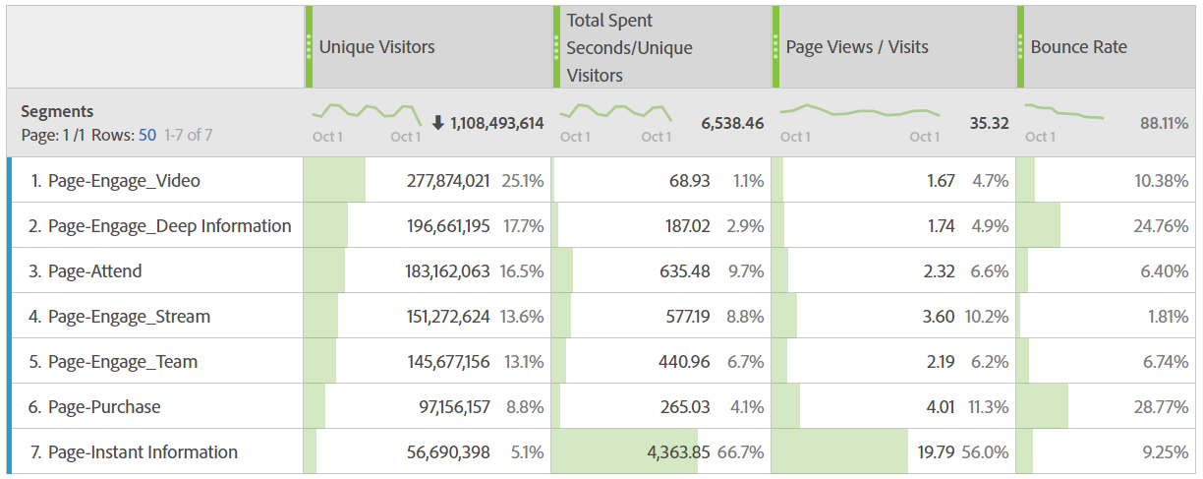
Key Behavior Trends
Exploring the behaviors of website users, this table identifies that potential new fans love stream and team element more than non-target groups
Total Visitors on website
Date: 2016/10/01 - 2019/10/01
Notes:
(20s)To understand the overall visitors’ traits on the platform of MLB for most of the public, we generated a segment of 50 top pages on the web for further analysis. Though the number of visitors on Steam and Team page (news, article, information, scores) are not the largest group, their bounce rate performance and total spent seconds/unique visitors are good. Therefore, Adobe analysis shows that the Stream and Team elements are the keys of our future strategies on our platform.

Slide 8
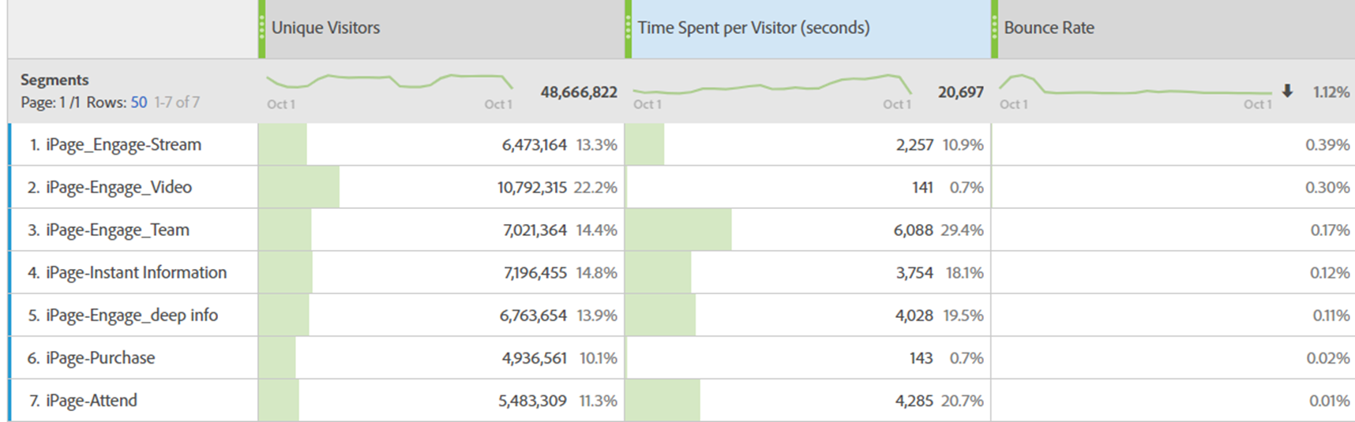
Engagement Barrier
To eliminate App visitors’ (new fans already) engagement barrier, we will provide customized contents and incentive to improve bounce rate and time spent on team and stream pages
App(IOS) Visitors
Date: 2017/10/01 - 2019/10/01
Notes:
(30s)App users who have already crossed the first high barrier - DOWNLOADING should be the people who are more willing to engage on Stream, Video, and Team page; however, the bounce rate(the highest three) and the time spent still have a large room to be improve: 1. To decrease the bounce rate of high engagement pages, we need to provide better and suitable content 2. To increase customers’ engaged time on watch games, we need to give incentive to keep them stay longer.

Slide 9
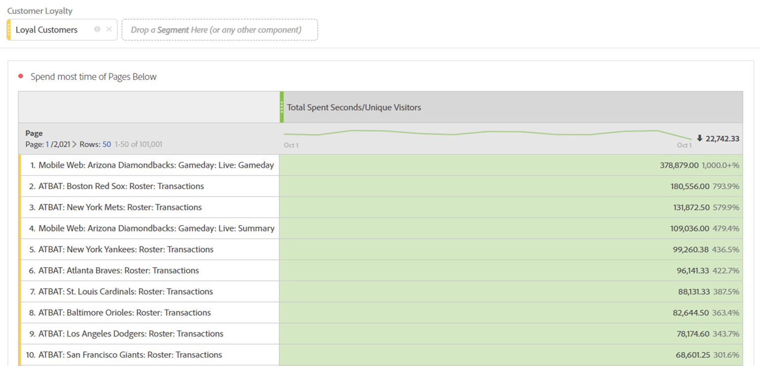
Loyalty Analysis
We should create long-term loyal program and proactively provide innovative team-focused membership based on their taste(team/stream), making them feel valued
Stream
Team
Stream
Team
Date: 2016/10/01 - 2019/10/01
Notes:
(30s)The original loyal customer dimension on Adobe Analytics Platform stop at ‘loyal customer’. We want to lead these loyal customers to the next frantic(purchase) level; therefore, we analyze and confirm what loyal customers really love on our platform. After analysis.

Slide 10
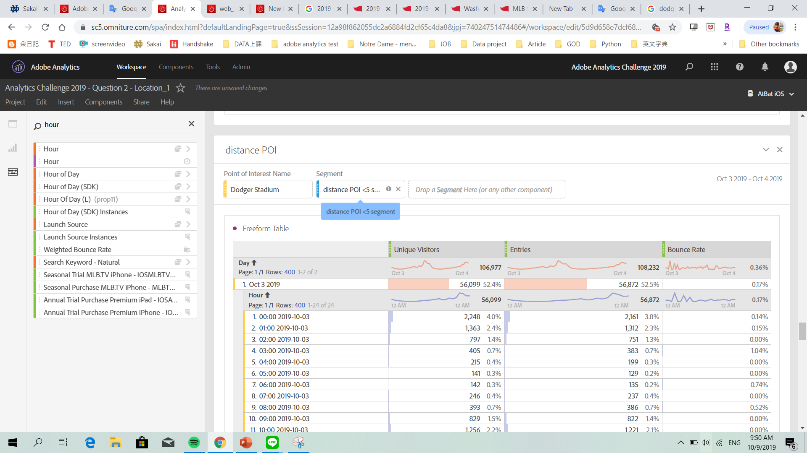
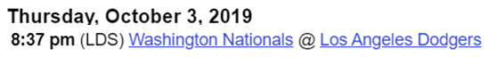
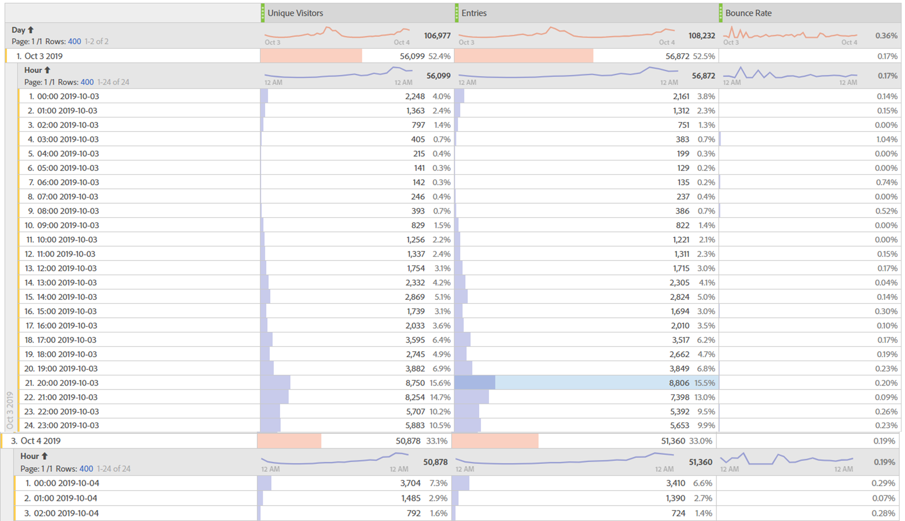
In-stadium Analysis | MLB Champion GO
In-stadium audiences normally hold their phones and enter then bounce a lot on related MLB pages, especially before and right after the few hours of game starts
Game Distance and Audience Mobile Data
Date: 2019/10/03 - 2019/10/04
Notes:
(30s)To analyze in-stadium behaviors, we choose observations of the game on October 3, 2019 in Los Angels, filtering audience by the distance of point of interest (Dodger Stadium) within 5, to test whether there are certain patterns, MLB could use to increase in-stadium experience and bring potential non-customers in stadium to on-line.
Many audiences will check their phone or logged in our app over and over again(High entry and high bounce) maybe for killing time and socializing during waiting. Our strategy is to use their waiting time to provide them unique AR experience which helps them to be more engaged with the game and the team or play together with their friend.

Slide 11
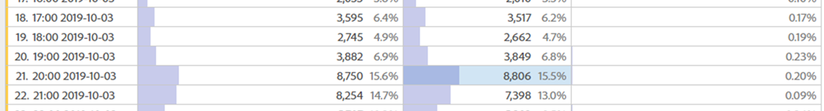
In-stadium Analysis | MLB Champion GO
Creating unique in-stadium experience on mobile during the waiting time in stadium is needed
Game Distance and Audience Mobile Data
Date: 2019/10/03 - 2019/10/04
Notes:
(10s)The analytics shows the existence of scattered time during waiting time before and after the game. To solve that problem, a probable strategy is to have some games or warm up to impress them positively in the waiting time.

Slide 12
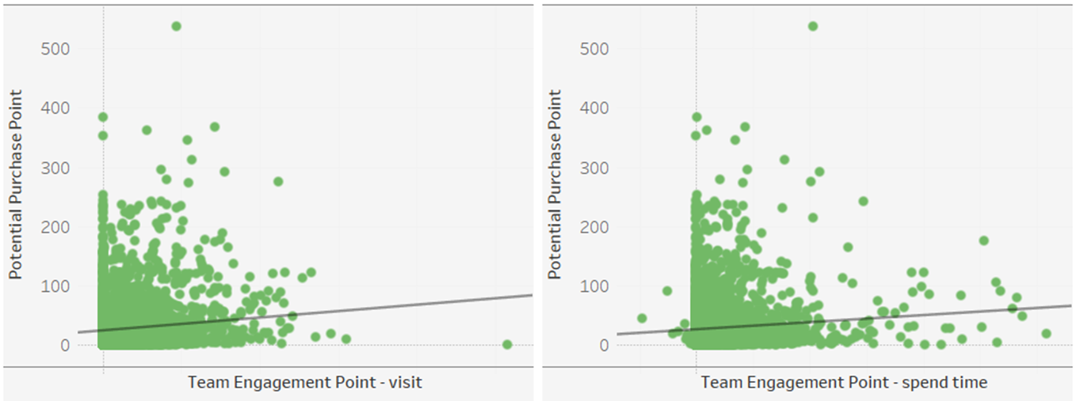
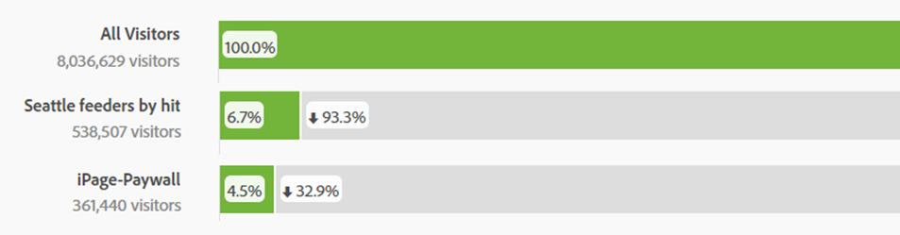
Potential Purchaser | Team Membership Strategy
Increasing team engage visit and spend time will boost purchase volume
Randomly sample
10% visitors in app
Date: 2017/10/01 - 2019/10/01
Notes:
(40s)After turning visitors or nonmembers to new fans, we want them to further engage as loyal members. By analyzing what elements will increase current customers’ interest on purchasing more whether membership or tickets(the definition of our Potential Purchase Point), we found that as long as we provide a better way for customers to engage more with team, the fans are willing to buy. Team Engagement Point calculated by their browsing behaviors- on TEAM(also matches the TEAM Element conclusion before) demonstrates their likability to turn into purchase.

Slide 13
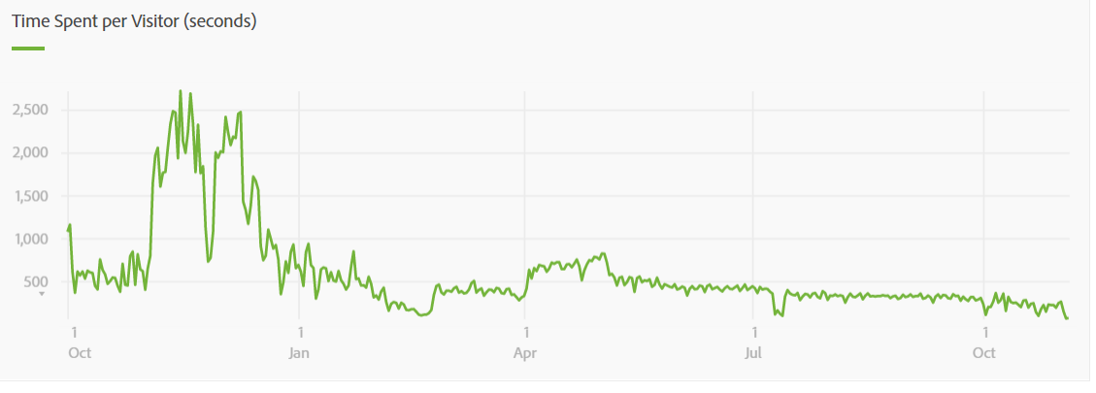
Challenge in Stream | Tokenized Gamble
The time spent for stream element, which our customers appreciate mostly, has gradually decreased. We should add more appealing elements in the stream
Mobile – audience on stream pages
Date: 2018/10/01 - 2019/10/07
Notes:
(20s)Besides the Team Elements, we want to optimized the other valuable element – Stream. We found that audiences spent less time on site within this year. Therefore, we analyzed the performance of events and finding which would be an attractive element to combine with Stream to improve Stream’s performance and increase the audiences’ willingness to watch the stream longer.

Slide 14
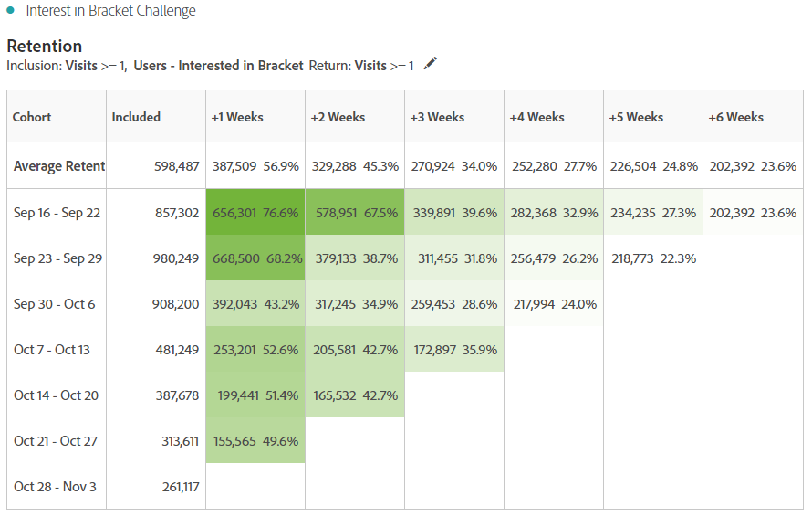
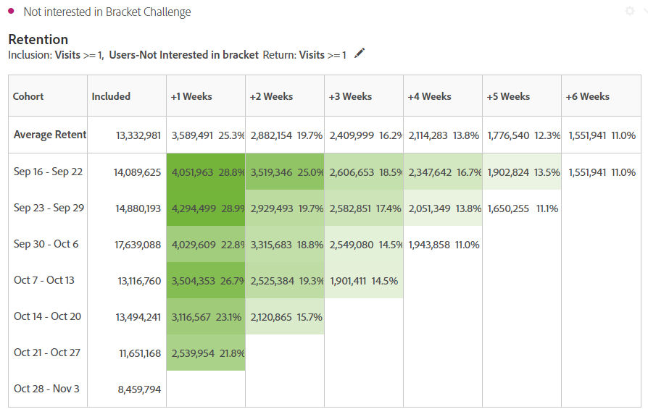
Combination of Elements | Tokenized Gamble
Among events and campaigns, MLB bracket challenges proven to double the retention rate, which is an element appealing enough to add into stream
Date: 2018/09/20 - 2018/10/31
Notes:
(30s)The cohort table select the time period within postseason Bracket Challenge, using retention method and the ‘Insterested in bracket’ demension (created and calculated by the browsing record) to found that customers who are attracted by bracket challenge also have a higher retention rate. We think the character of this campaign is what we want. Therefore, we extracted the ‘gambling/guessing’ concept and formulated it into our Tokenized Gamble strategies.

Slide 15
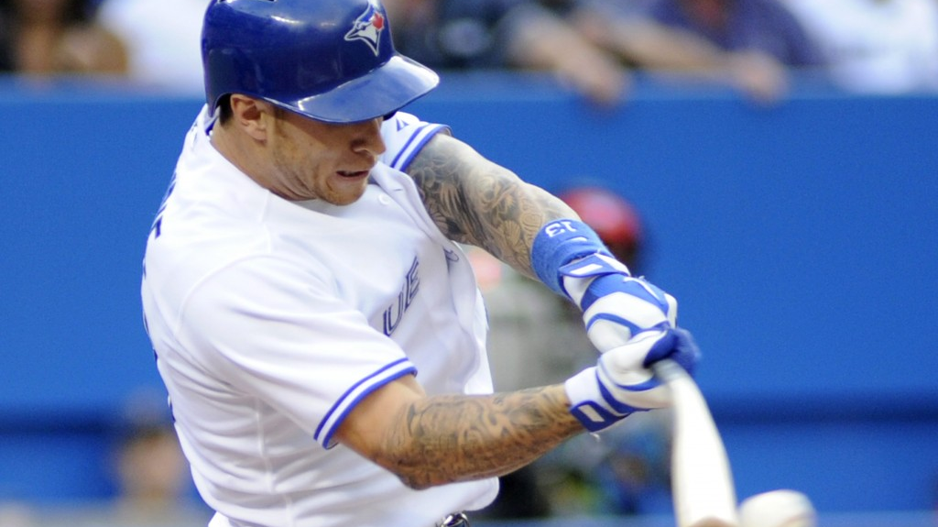
Cleanup is ready
Four strategies to bash these challenges right away

Slide 16
MLB Champion GO
Enriches in-stadium experience and grows interests in baseball for non-fans
A Pokemon GO style AR pre-game of pitching or batting against virtual home team players
Instant rewards include free hotdog, parking tickets, and souvenirs for audiences arrive early
Non-fans learn home team, history, and baseball rules
MLB Champion GO
Date: 2018/09/16 - 2018/11/10
Notes:
(50s)This strategy improves the utilization of scatter time at tailgate and during the game.
This encourages Audience to arrive earlier and Improve check-in efficiency.
For rookie fans, this AR pre-game will foster their interest in home team.

Slide 17
Team Membership
Identifies team-based market segmentation and evolves new fans
An economic and home team-focused Information push and live broadcast services
Personalized rewards include free tickets, family game trip, day with star
New fans experience customized loyal program through fan segmentation
NYY
Team Member
Date: 2018/09/16 - 2018/11/10
Notes:
(50s)The memberships pricing at $9.9 lower barriers for potential fans and meets fans team-oriented needs.
Fans spend more time for memorable and interactive experience and foster their loyalty to their home teams.
Through segmentation, unique and attractive loyal programs are created to cater to fans’ demands..

Slide 18
Tokenized Gamble
Brings thrill of watching live games and cultivates team-centered loyal fans
Gamble includes cash-divided brackets and tokenized bets on scores and team per game
Customized experiential rewards can be exchanged by accumulated member tokens
Loyal fans are entrapped to engage with home teams
Tokenized Gambles
Date: 2018/09/16 - 2018/11/10
Notes:
(50s)Multiple gambles offer fans instant excitement while watching live games and enhance average watching time.
Customized rewards encourage fans to follow home teams’ pre-game and postgame events.
Moreover, this strategy enhances the stickiness and builds bonds between loyal fans and team.

Slide 19
Virtual Space
Constructs bounded community for distant frantic fans and passes baseball tradition to next generation in next ten years
An VR based, interactive space providing real-time, in stadium
Conserve bounds among families, across distances and between generations
Frantic fans knit a space of offline and online, past and future together
Virtual Space
Date: 2018/09/16 - 2018/11/10
Notes:
(50s) Virtual Space connects VR users together, even distant fans can socialize and share same in-stadium excitement.
This technology creates a personalized virtual space for distant families, even working-abroad parents and at-home children can preserve baseball of watching games together.
Moreover, a bounced community of various families, frantic fans, and young non fans will be created.

Slide 20
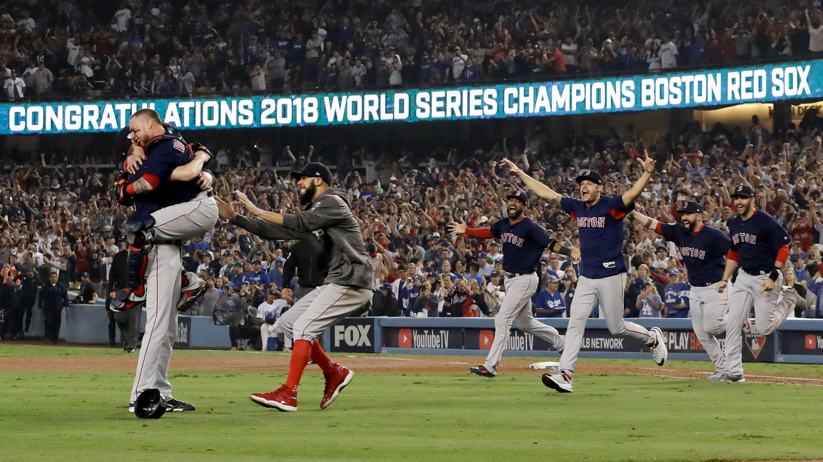
Conclusion
Summarize strategies as a whole

Slide 21
As a Core Problem
Limited connection lead to high fan lost rate and restrain the growth of MLB’s revenue and partners’ revenue
Audiences
Ticket
Sponsors
MLB’s Sport Assets:
League, Teams, Players
Sport Media
Date: 2018/09/16 - 2018/11/10
Notes:
(15s)For current industry, the main problem is that tickets are the main connection between audiences and sports assets. The limited tie causes high fans loss rate and also lead to decrease in TV streaming subscription ,Sponsorship effect and direct revenue.

Slide 22
A Bundle Solution
These four diamonds strategies empower future growth of MLB as the leader among professional sport leagues in next ten years.
Audience
Non Fans
New Fans
Loyal Fans
Frantic Fans
Champion
GO
Team
Membership
Tokenized
Gamble
Virtual
Space
Interest
Engage
Honor
Community
Sponsors
Sport Media
MLB’s Sport Assets:
League, Teams, Players
Notes:
(60s)Through dividing various fans by engagement degree, we can provide customized services and enjoyment for each step of fans. A strong knit between audiences and MLB and fan segmentation would promote revenue for other partners. Lower price of Membership fee can let sports media attract more potential fans to subscribe streaming services. Sponsors can target specific fans to propagate their products.

Slide 23
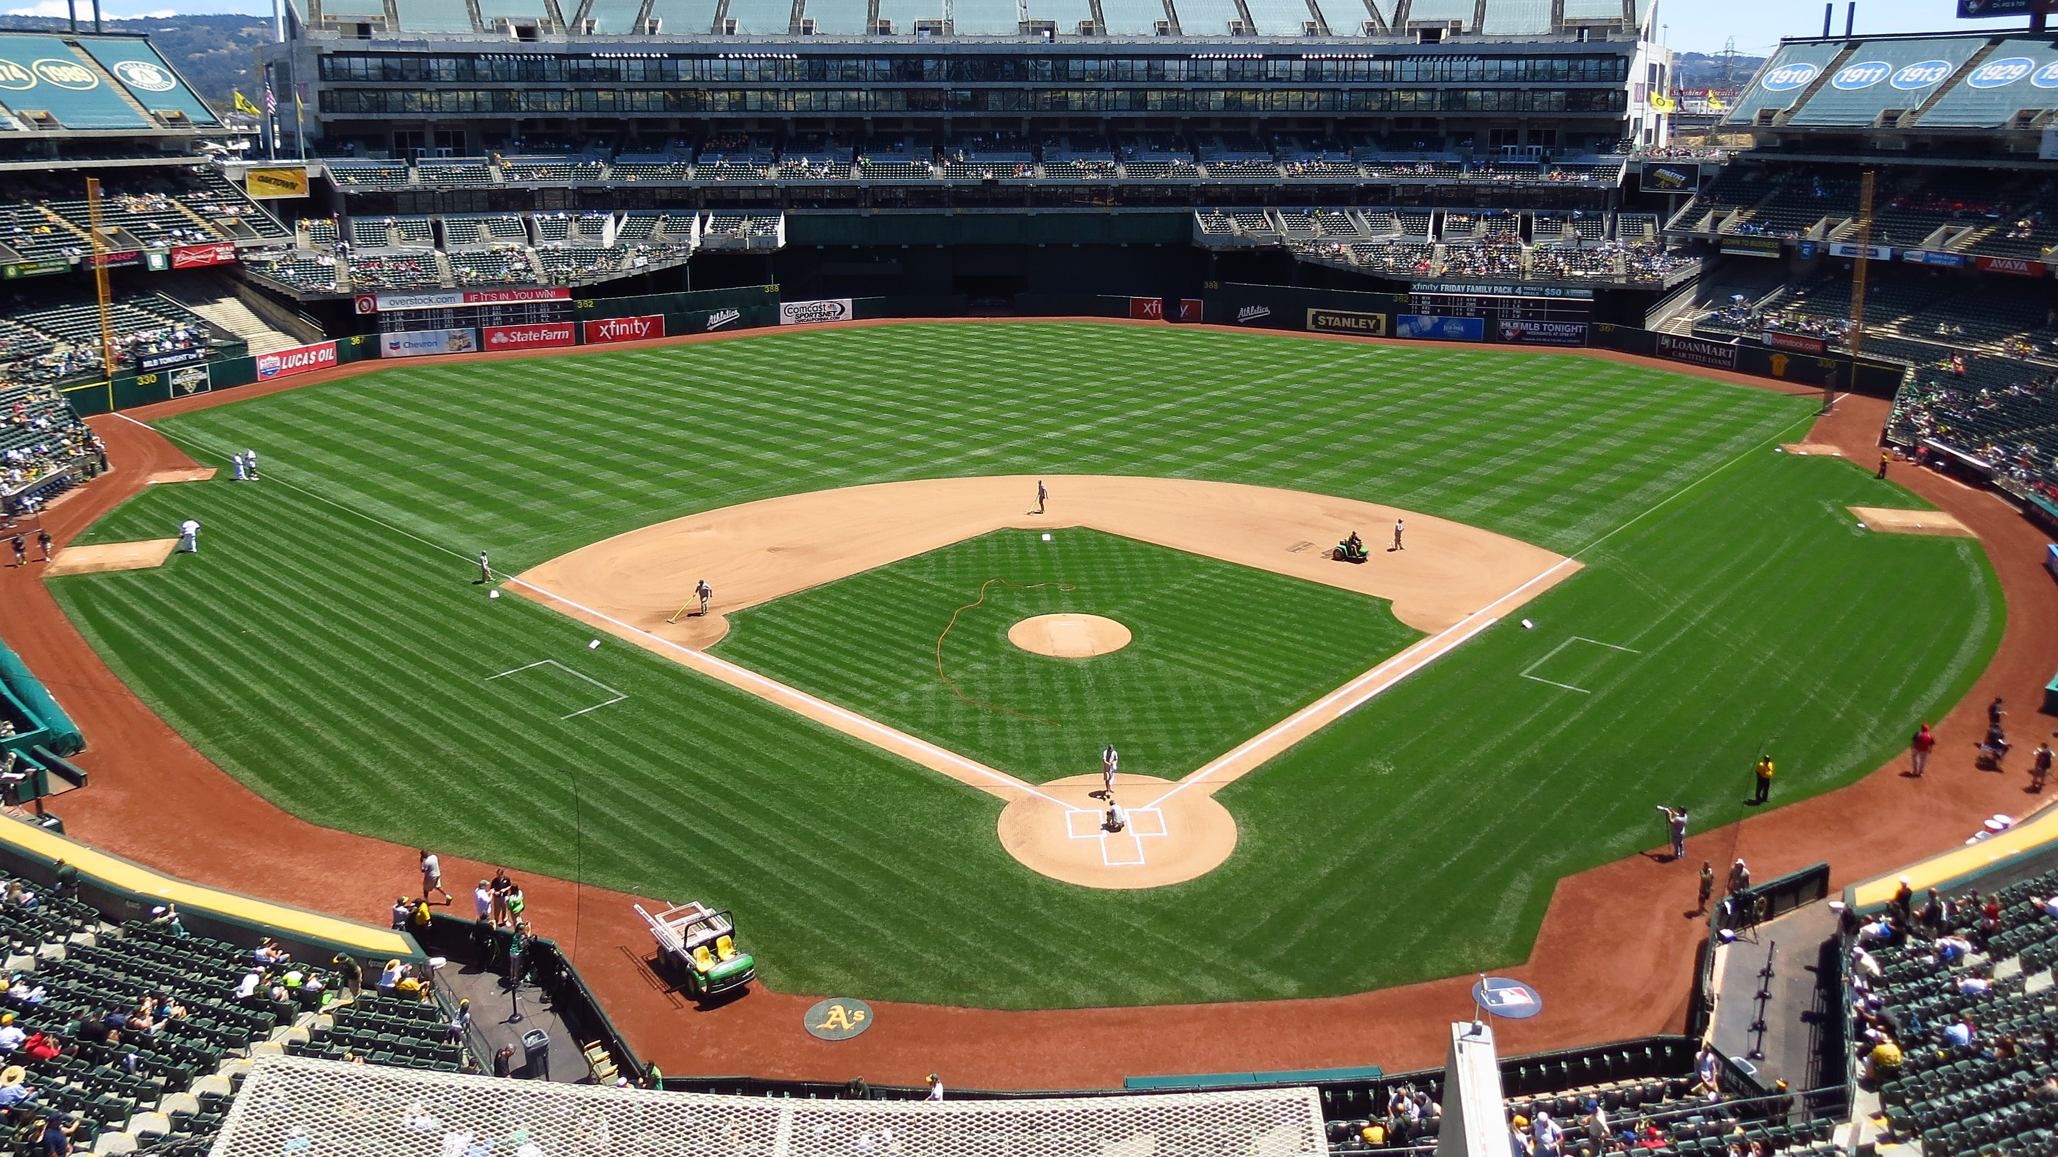
Start Your Own Game
Notes:
Your wanna your own game? Let’s get it!

Slide 24
Notes:
Thank you!

